Slide 1
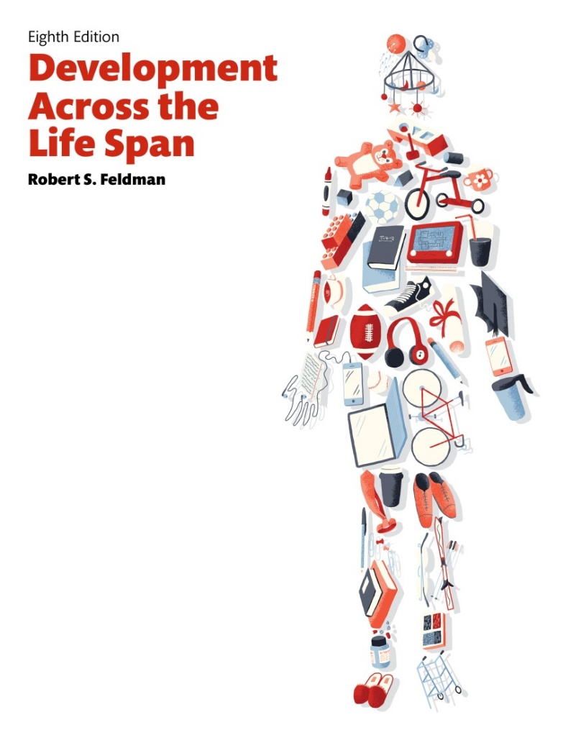
Development Across the Life Span
Eighth Edition
Chapter 8
Social and Personality Development in the Preschool Years
Slides in this presentation contain hyperlinks. JAWS users should be able to get a list of links by using INSERT+F7
Copyright © 2017, 2014, 2011 Pearson Education, Inc. All Rights Reserved
Notes:
If this PowerPoint presentation contains mathematical equations, you may need to check that your computer has the following installed:
1) MathType Plugin
2) Math Player (free versions available)
3) NVDA Reader (free versions available)

Slide 2
Learning Objectives (1 of 3)
8.1 Describe the major developmental challenges that preschool-age children face.
8.2 Explain how preschool-age children develop a concept of themselves.
8.3 Explain how preschool-age children develop a sense of racial identity and gender.
8.4 Describe the sorts of social relationships that preschool-age children engage in.

Slide 3
Learning Objectives (2 of 3)
8.5 Explain how and why preschool-age children play.
8.6 Summarize how thinking changes in the preschool years.
8.7 Describe ways in which family relationships affect the development of preschool-age children.
8.8 Describe the kinds of disciplinary styles parents employ with preschool-age children and what effects they have.

Slide 4
Learning Objectives (3 of 3)
8.9 List the factors that contribute to child abuse and neglect.
8.10 Define resilience, and describe how can it help abused children.
8.11 Explain how preschool-age children develop a moral sense.
8.12 Describe how aggression develops in preschool-age children.

Slide 5
Forming a Sense of Self
8.1 Describe the major developmental challenges that preschool-age children face.
8.2 Explain how preschool-age children develop a concept of themselves.
8.3 Explain how preschool-age children develop a sense of racial identity and gender.

Slide 6
Psychosocial Development: Resolving the Conflicts
Psychosocial development encompasses changes in individuals’ understanding of both themselves and others’ behavior
Preschool years largely encompass what Erikson called the initiative-versus-guilt stage, which lasts from around age three to age six
  Initiative: desire to act independently from parents and becoming autonomous
  Guilt: guilt of unintended consequences resulting in shame and self-doubt
Notes:
Psychosocial development encompasses changes both in individuals’ understanding of themselves and their understanding of others’ behavior.
Society and culture present the developing person with particular challenges, which shift as people age. Erikson believed that people pass through eight distinct stages, each characterized by a crisis or conflict which the person must resolve.
Our experiences as we try to resolve these conflicts lead us to develop ideas about ourselves that can last for the rest of our lives.
In the early part of the preschool period, children are ending autonomy-versus-shame-and-doubt stage, which lasts from around 18 months to 3 years. In this period, children either become more independent and autonomous if their parents encourage exploration and freedom or they experience shame and self-doubt if they are restricted and overprotected.

Slide 7
Self-Concept in the Preschool Years:
Thinking about the Self
Self-concept or identity: Set of beliefs about what we are like as individuals
Preschooler self-concept
  Not “accurate”
  More optimistic
  Overestimates of abilities
Tasks
  Becoming one’s own person
  Making own decisions
  Shaping kind of person she or he is becoming
Notes:
Although the question “Who am I?” is not explicitly posed by most preschool-age children, it underlies a considerable amount of development during the preschool years. During this period, children wonder about the nature of the self, and the way they answer the “Who am I?” question may affect them for the rest of their lives.

Slide 8
Cultural Influence
View of self is culturally bound
  Collectivist Orientation: Asian
  Individualistic Orientation: Western
View of self is family tied
View of self is individually directed
Notes:
Preschool-age children's view of themselves also reflects the way their particular culture considers the self.
For example, many Asian societies tend to have a collectivistic orientation, promoting the notion of interdependence.
People in such cultures tend to regard themselves as parts of a larger social network in which they are interconnected with and responsible to others.
In contrast, children in Western cultures are more likely to develop a view of the self reflecting an individualistic orientation that emphasizes personal identity and the uniqueness of the individual.
They are more apt to see themselves as self-contained and autonomous, in competition with others for scarce resources.

Slide 9
Race Dissonance
Minority children indicate preferences for majority values or people
Result of powerful influence of dominant culture
Not disparagement of own racial characteristics
Notes:
Race dissonance, the phenomenon in which minority children indicate preferences for majority values or people.
Some studies find that as many as 90 percent of African American children, when asked about their reactions to drawings of black and white children, react more negatively to the drawings of black children than to those of white children.
However, these negative reactions did not translate into lower self-esteem for the African American subjects.
Instead, their preferences appear to be a result of the powerful influence of the dominant white culture, rather than a disparagement of their own racial characteristics.

Slide 10
Ethnic Identity
Emerges somewhat later than racial identity
  Usually less conspicuous than race
Preschoolers who are bilingual, speaking both Spanish and English, are more apt to be aware of ethnic identity
Notes:
For instance, in one study of Mexican American ethnic awareness, preschoolers displayed only a limited knowledge of their ethnic identity. However, as they became older, they grew more aware of the significance of their ethnicity.

Slide 11
Gender Identity
Sense of being male or female
Well established by preschool years
Same-sex preferences appear in many cultures
By age 2 years
  Consistently label themselves and others as male or female

Slide 12
Gender and Play
Differences noted in play of male and female preschoolers
Males
  More rough and tumble play
  Same-sex playmate preference around age three years
Females
  Organized games and role playing
  Same-sex playmate preference around age two years

Slide 13
Gender Expectations
Expectations about gender-appropriate behavior more rigid and gender-stereotyped than adult attitudes up to 5 years
Gender outweighs ethnic variables

Slide 14
Preschoolers’ Gender Expectations
Preschoolers expect boys to demonstrate:
  Competence
  Independence
  Forcefulness
  Competitiveness
Preschoolers expect girls to demonstrate:
  Warmth
  Expressiveness
  Nurturance
  Submissiveness

Slide 15
Theoretical Perspectives on Gender
Biological
  Inborn, genetic factors produce gender differences
Psychoanalytic
  Gender differences result of moving through series of stages related to biological urges
Social learning
  Gender-related behavior learned from observations of others’ behaviors
Cognitive
  Gender schemes form a lens through which the world is viewed

Slide 16
Psychoanalytic Perspective on Gender
Males and females go through different identification processes
Identifying with same-sex parents enables child to adopt parents’ gender attitudes and values

Slide 17
Social Learning Perspective on Gender
Gender-related behaviors and expectations learned from observing others
Books, media, television perpetuate gender-related behavior and expectations

Slide 18
Cognitive Perspective on Gender
Gender schema or cognitive framework organizes relevant gender information
Preschoolers begin developing “rules” about what is right and inappropriate for males and females
Androgynous children
  Encouraged to follow gender roles that encompass characteristics thought typical of both sexes

Slide 19
Four Approaches to Gender Development
(1 of 2)
Perspective | Key Concepts | Applying the Concepts to Preschool Children
Biological | Our ancestors who behaved in ways that are now stereotypically feminine or masculine may have been more successful in reproducing. Brain differences may lead to gender differences. | Girls may be genetically “programmed” by evolution to be more expressive and nurturing, while boys are “programmed” to be more competitive and forceful. Abnormal hormone exposure before birth has been linked to both boys and girls behaving in ways typically expected of the other gender.
Psychoanalytic | Gender development is the result of identification with the same-sex parent, achieved by moving through a series of stages related to biological urges. | Girls and boys whose parents of the same sex behave in stereotypically masculine or feminine ways are likely to do so, too, perhaps because they identify with those parents.

Slide 20
Four Approaches to Gender Development
(2 of 2)
Perspective | Key Concepts | Applying the Concepts to Preschool Children
Social Learning | Children learn gender-related behavior and expectations from their observation of others’ behavior. | Children notice that other children and adults are rewarded for behaving in ways that conform to standard gender stereotypes-and sometimes punished for violating those stereotypes.
Cognitive | Through the use of gender schemas, developed early in life, preschoolers form a lens through which they view the world. They use their increasing cognitive abilities to develop “rules” about what is appropriate for males and females. | Preschoolers are more rigid in their rules about proper gender behavior than people at other ages, perhaps because they have just developed gender schemas that don’t yet permit much variation from stereotypical expectations.

Slide 21
Friends and Family: Preschoolers’ Social Lives (1 of 2)
8.4 Describe the sorts of social relationships that preschool-age children engage in.
8.5 Explain how and why preschool-age children play.
8.6 Summarize how thinking changes in the preschool years.
8.7 Describe ways in which family relationships affect the development of preschool-age children.

Slide 22
Friends and Family: Preschoolers’ Social Lives (2 of 2)
8.8 Describe the kinds of disciplinary styles parents employ with preschool-age children and what effects they have.
8.9 List the factors that contribute to child abuse and neglect.
8.10 Define resilience, and describe how can it help abused children.

Slide 23
The Development of Friendships
View of friendship evolves with age
Older preschoolers see friendship as a continuing state and a stable relationship
Begin to understand concepts such as trust, support, shared interest

Slide 24
Playing by the Rules: The Work of Play
Children are interested in maintaining smooth social relationships with friends
Children try to avoid and/or solve disagreements
Play is critical to the overall development of young children
Changes over time
Becomes more sophisticated, interactive, cooperative
Gradually more dependent on social and cognitive skills

Slide 25
Categorizing Play (1 of 2)
Types of play
Functional play: simple, repetitive activities typical of 3-year-olds that may involve objects or repetitive muscular movements
Constructive play: activities in which children manipulate objects to produce or build something

Slide 26
Categorizing Play (2 of 2)
By age four, children engage in constructive play that:
Tests developing cognitive skills
Practices motor skills
Facilitates problem solving
Teaches cooperation

Slide 27
Social Aspects of Play (1 of 2)
Parallel Play
  Children play with similar toys, in a similar manner, but do not interact with each other
Onlooker Play
  Children simply watch each other play
Solitary Play
  Children play by themselves

Slide 28
Social Aspects of Play (2 of 2)
Associative Play
  Children interact with one another in groups of two or more
  Children share or borrow toys or materials, but do not do the same activity
Cooperative Play
  Children play with one another, take turns, play games, and devise contests

Slide 29
Preschoolers’ Play (1 of 3)
Type of Play | Description | Examples
General Categories | blank | blank
Functional play | Simple, repetitive activities typical of 3-year-olds. May involve objects or repetitive muscular movements. | Moving dolls or cars repetitively. Skipping, jumping, rolling or unrolling a piece of clay.
Constructive play | More sophisticated play in which children manipulate objects to produce or build something. Developed by age 4, constructive play lets children test physical and cognitive skills and practice fine muscle movements. | Building a dollhouse or car garage out of Legos, putting together a puzzle, making an animal out of clay.
Social Aspects of Play (Parten’s Categories) | blank | blank

Slide 30
Preschoolers’ Play (2 of 3)
Type of Play | Description | Examples
Parallel play | Children use similar toys in a similar manner at the same time, but do not interact with each other. Typical of children during the early preschool years. | Children sitting side by side, each playing with his or her own toy car, putting together his or her own puzzle, or making an individual clay animal.
Onlooker play | Children simply watch others at play, but do not actually participate. They may look on silently or they may make comments of encouragement or advice. Common among preschoolers and can be helpful when a child wishes to join a group already at play. | One child watches as a group of others plays with dolls, cars, or clay; builds with Legos, or works on a puzzle together.
Associative play | Two or more children interact, sharing or borrowing toys or materials, although they do not do the same thing. | Two children, each building his or her own Lego garage, may trade bricks back and forth.

Slide 31
Preschoolers’ Play (3 of 3)
Type of Play | Description | Examples
Cooperative play | Children genuinely play with one another, taking turns, playing games, or devising contests. | A group of children working on a puzzle may take turns fitting in the pieces. Children playing with dolls or cars may take turns making the dolls talk or may agree on rules to race the cars.

Slide 32
The Great Pretenders
Nature of pretend play , or make-believe, changes during the preschool period
Becomes increasingly unrealistic and more imaginative
Change from using only realistic objects to using less concrete ones
Notes:
At the start of the preschool period, children may pretend to listen to a radio only if they actually have a plastic radio that looks realistic. Later, however, they are more likely to use an entirely different object, such as a large cardboard box, as a pretend radio.

Slide 33
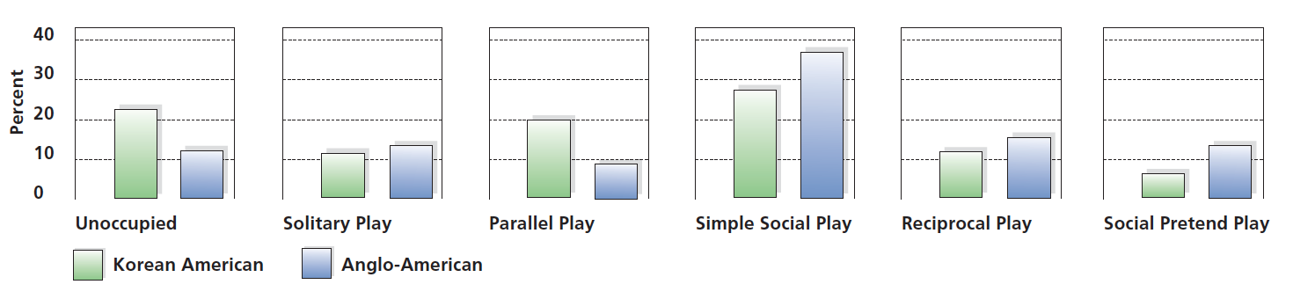
Figure 8-1 Comparing Play Complexity
An examination of Korean American and Anglo-American preschoolers’ play complexity finds clear differences in patterns of play.Can you think of any explanation for this finding?
(Source: Based on Farver, Kim, & Lee-Shin, 1995.)

Slide 34
Preschoolers’ Theory of Mind
Using their theory of mind, preschool children are able to generate explanations for how others think and reasons for why they behave the way they do
  Imagine things not physically present
  Pretend and react to imagined events
  Know that others have this capability
  Begin to understand motives
  Most have an incomplete understanding of “beliefs”
  Some can solve false belief problems
Notes:
Theory of mind refers to knowledge and beliefs about how the mind operates.

Slide 35
Emergence of Theory of Mind
Emergence related to
Brain maturation
Hormonal changes
Developing language
Opportunities for social interaction and pretend play
Cultural background
Notes:
Theory of mind refers to knowledge and beliefs about how the mind operates.

Slide 36
Preschoolers’ Family Lives
Many preschoolers face an increasingly complex world
Increased number of single-parent-headed families
Strong, positive relationships within families encourage relationships with other children
For most children this is not a time of upheaval and turmoil
Notes:
In 1960, less than 10 percent of all children under the age of 18 lived with one parent. In 2000, a single parent headed 21 percent of white families, 35 percent of Hispanic families, and 55 percent of African-American families.

Slide 37
Effective Parenting: Teaching Desired Behavior (1 of 2)
Authoritarian
  Exhibit controlling, rigid, cold style
  Value strict, unquestioning obedience
Authoritative
  Set firm, clear, consistent limits
  Allow disagreement and use reasoning, explanations, consequences
Notes:
See Table 8.3
Types of Parenting and Discipline Patterns (Baumrind, 1980)

Slide 38
Effective Parenting: Teaching Desired Behavior (2 of 2)
Permissive-indifferent
  Uninvolved in children’s lives
  Set few limits
Permissive-indulgent
  Involved with children
  Place little or no limits or control on children’s behavior
Notes:
See Table 8.3
Types of Parenting and Discipline Patterns (Baumrind, 1980)

Slide 39
Parenting Styles (1 of 2)
How Demanding Parents Are of Children | Demanding | Undemanding
How responsive Parents Are to a Child | Authoritative | Permissive
Highly Responsive | Characteristics: firm, setting clear and consistent limits. Relationship with Children: Although they tend to be relatively strict, like authoritarian parents, they are loving and emotionally supportive and encourage their children to be independent. They also try to reason with their children, giving explanations for why they should behave in a particular way, and communicate the rationale for any punishment they may impose. | Characteristics: lax and inconsistent feedback. Relationship with Children: They require little of their children, and they don’t see themselves as holding much responsibility for how their children turn out. They place little or no limits or control on their children’s behavior.

Slide 40
Parenting Styles (2 of 2)
Low Responsive | Authoritarian | Uninvolved
blank | Characteristics: controlling, punitive, rigid, cold. Relationship with Children: Their word is law, and they value strict, unquestioning obedience from their children. They also do not tolerate expressions of disagreement. | Characteristics: displaying indifferent, rejecting behavior. Relationship with Children: They are detached emotionally and see their role as only providing food, clothing, and shelter. In its extreme form, this parenting style results in neglect, a form of child abuse.

Slide 41
Effective Parenting (1 of 2)
Authoritarian parents: withdrawn, socially awkward children
Permissive parents: dependent, moody, low social-skilled children
Uninvolved parents: emotionally detached, unloved, and insecure children
Notes:
Children of authoritarian parents tend to be withdrawn, showing relatively little sociability. They are not very friendly, often behaving uneasily around their peers. Girls who are raised by authoritarian parents are especially dependent on their parents, whereas boys are unusually hostile.
Permissive parents have children who, in many ways, share the undesirable characteristics of children of authoritarian parents. Children with permissive parents tend to be dependent and moody, and they are low in social skills and self-control.
Children whose parents show uninvolved parenting styles are the worst off. Their parents’ lack of involvement disrupts their emotional development considerably, leading them to feel unloved and emotionally detached, and impedes their physical and cognitive development as well.
Children of authoritative parents fare best. They generally are independent, friendly with their peers, self-assertive, and cooperative. They have strong motivation to achieve, and they are typically successful and likable. They regulate their own behavior effectively, both in terms of their relationships with others and emotional self-regulation.

Slide 42
Effective Parenting (2 of 2)
Authoritative parents: independent, friendly, self-assertive, and cooperative children
Childrearing practices that parents are urged to follow reflect cultural perspectives
No single parenting pattern or style is likely to be universally appropriate or likely to invariably produce successful children
Notes:
Children of authoritarian parents tend to be withdrawn, showing relatively little sociability. They are not very friendly, often behaving uneasily around their peers. Girls who are raised by authoritarian parents are especially dependent on their parents, whereas boys are unusually hostile.
Permissive parents have children who, in many ways, share the undesirable characteristics of children of authoritarian parents. Children with permissive parents tend to be dependent and moody, and they are low in social skills and self-control.
Children whose parents show uninvolved parenting styles are the worst off. Their parents’ lack of involvement disrupts their emotional development considerably, leading them to feel unloved and emotionally detached, and impedes their physical and cognitive development as well.
Children of authoritative parents fare best. They generally are independent, friendly with their peers, self-assertive, and cooperative. They have strong motivation to achieve, and they are typically successful and likable. They regulate their own behavior effectively, both in terms of their relationships with others and emotional self-regulation.

Slide 43
Child Abuse and Psychological Maltreatment
Five children are killed daily by caretakers or parents in the United States
140,000 are physically injured
Three million are abused or neglected annually in U.S.

Slide 44
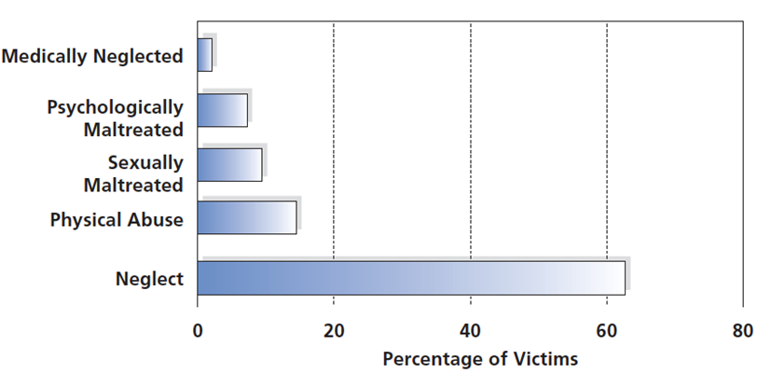
Figure 8-2 Types of Child Abuse
Neglect is the most frequent form of abuse. How can educators and
health-care providers help identify cases of child abuse?
(Source: Child Welfare Information Gateway. https://www.childwelfare.gov/pubs/factsheets /fatality/, 2015.)
Notes:
Neglect is the most frequent form of abuse. How can educators and health-care providers help identify cases of child abuse?
(Source: U.S. Department of Health and Human Services, Administration on Children, Youth and Families, 2007.)

Slide 45
Stressful Environments Increase Likelihood of Abuse
Poverty
Single-parent homes
High levels of marital discord
Substance abuse

Slide 46
Warning Signs of Child Abuse (1 of 3)
Because child abuse is typically a secret crime, identifying the victims of abuse is particularly difficult. Nonetheless, there are several signs in a child that indicate that he or she is the victim of violence (Robbins, 1990):
Visible, serious injuries that have no reasonable explanation
Bite or choke marks
Burns from cigarettes or immersion in hot water
Feelings of pain for no apparent reason

Slide 47
Warning Signs of Child Abuse (2 of 3)
Fear of adults or care providers
Inappropriate attire in warm weather (long sleeves, long pants, high-necked garments)—possibly to conceal injuries to the neck, arms, and legs
Extreme behavior—highly aggressive, extremely passive, extremely withdrawn
Fear of physical contact

Slide 48
Warning Signs of Child Abuse (3 of 3)
If you suspect a child is a victim of aggression, it is your responsibility to act. Call your local police or the department of social services in your city or state, or call Child Help U.S.A. at 1-800-422-4453. Remember, by acting decisively you can literally save someone’s life.

Slide 49
Reasons for Physical Abuse
Children are more likely to be victimized when they are:
Fussy / Resistant to control / Slow to adapt to new situations
Overly anxious / Frequent bedwetters / Developmentally delayed
Vague demarcation between permissible and impermissible forms of physical violence
  Line between “spanking” and “beating” is not clear
  Spankings begun in anger can escalate into abuse
  Privacy of child care setting
  Unrealistic parental expectations
Children are never responsible for their abuse

Slide 50
What Do The Experts Tell Us About Causality?
Tension Building
Abusing Incident
Making Up
Cycle-of-violence hypothesis argues that the abuse and neglect children suffer predispose them to be abusive adults
Notes:
Victims of abuse have learned from their childhood experiences that violence is an appropriate and acceptable form of discipline. Violence may be perpetuated from one generation to another, as each generation learns to behave abusively (and fails to learn the skills needed to solve problems and instill discipline without resorting to physical violence) through its participation in an abusive, violent family.

Slide 51
Psychological Maltreatment
Not all abuse is physical
Psychological maltreatment
  Occurs when parents or other caretakers harm children’s behavioral, cognitive, emotional, or physical functioning
  May take the form of neglect, in which parents may ignore the child or act emotionally unresponsive
  Not as easily identified without outward physical signs
Notes:
Abusive parents may frighten, belittle, or humiliate their children, thereby intimidating and harassing them.
Children may be made to feel like disappointments or failures, or they may be constantly reminded that they are a burden to their parents.
Parents may tell their children that they wish they had never had children and specifically that they wish that their children had never been born.
Children may be threatened with abandonment or even death. In other instances, older children may be exploited. They may be forced to seek employment and then to give their earnings to their parents.

Slide 52
Consequences of Psychological Maltreatment
Some children survive and grow into psychologically healthy adults
Others suffer long-term damage
  Low self-esteem, depression, suicide
  Lying
  Misbehavior
  Underachievement in school
  Criminal behavior

Slide 53
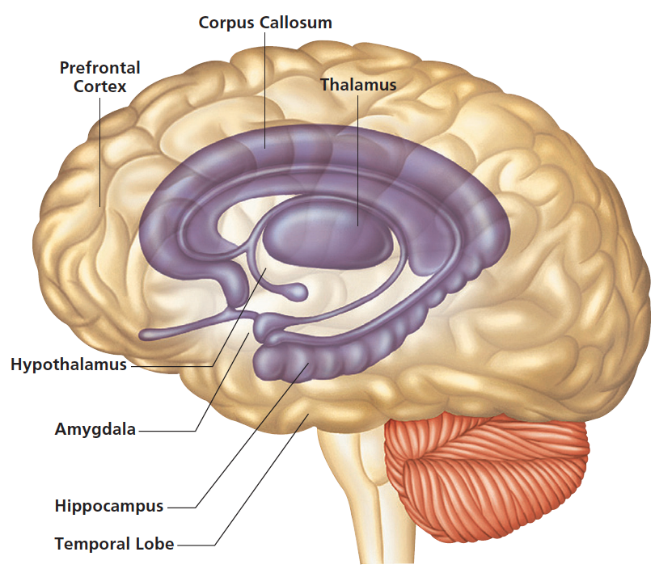
Figure 8-3 Abuse Alters the Brain
The limbic system, comprised of the hippocampus and amygdala, can be permanently altered as a result of childhood abuse.
Notes:
Figure 8-3 Abuse Alters the Brain
The limbic system, comprised of the hippocampus and amygdala,
can be permanently altered as a result of childhood abuse.
The stress, fear, and terror produced by abuse may also produce permanent changes in the brain due to overstimulation of the limbic system. Because the limbic system is involved in the regulation of memory and emotion, the result can be antisocial behavior during adulthood.

Slide 54
Resilience: Overcoming the Odds
Resilience
Ability to overcome circumstances that place child at high risk for psychological and/or physical damage
Resilient children
Exhibit ability to overcome circumstances that place child at high risk for psychological and/or physical functioning

Slide 55
Moral Development and Aggression
8.11 Explain how preschool-age children develop a moral sense.
8.12 Describe how aggression develops in preschool-age children.
Notes:
Moral development refers to changes in people's sense of justice and of what is right and wrong, and in their behavior related to moral issues.

Slide 56
Moral Development: Following Society’s Rights and Wrongs
Moral development: Children’s reasoning about morality, their attitudes toward moral lapses, and their behavior when faced with moral issues
Changes in sense of justice and of right and wrong
Changes in behavior related to moral issues
Several approaches have evolved
Piaget’s view of moral development
Social learning approaches to morality
Genetic approaches to morality

Slide 57
Moral Development: Piaget (1 of 2)
Heteronomous Morality
  4 to 7 years
  Rules seen as invariant, unchangeable, and beyond child’s control and/or influence
  Intentions not considered
  Believe in immanent justice (immediate punishment for infractions)

Slide 58
Moral Development: Piaget (2 of 2)
Incipient Cooperation Stage
  7 to 10 years
  Become more social and learn the rules
  Play according to shared conception of rules
Autonomous Cooperation Stage
  Beginning at 10 years
  Become fully aware that rules may and can be modified if people playing agree

Slide 59
Evaluating Piaget’s Approach to Moral Development
Accurate descriptions of how moral development proceeds
Underestimates ages at which children’s moral skills develop
Notes:
It is now clear that preschool-age children understand the notion of intentionality by about age 3, and this allows them to make judgments based on intent at an earlier age than Piaget supposed. Specifically, when provided with moral questions that emphasize intent, preschool children judge someone who is intentionally bad as more “naughty” than someone who is unintentionally bad, but who creates more objective damage. Moreover, by the age of 4, they judge intentional lying wrong.

Slide 60
Moral Development: Social Learning (1 of 2)
Children do more than simply mimic unthinkingly
Environment produces prosocial behavior
Moral conduct learned through reinforcement and modeling
Preschoolers more apt to model behavior of warm, responsive, competent, high-prestige adults and peers
Notes:
Not all models are equally effective in producing prosocial responses.
Preschoolers are more apt to model the behavior of warm, responsive adults than of adults who appear colder.
Models viewed as highly competent or high in prestige are more effective than others.

Slide 61
Moral Development: Social Learning (2 of 2)
By observing moral conduct, children are reminded of
Society’s norms about importance of moral behavior as conveyed by significant others
Connections between particular situations and certain kinds of behavior
Abstract modeling
Notes:
Not all models are equally effective in producing prosocial responses.
Preschoolers are more apt to model the behavior of warm, responsive adults than of adults who appear colder.
Models viewed as highly competent or high in prestige are more effective than others.

Slide 62
Moral Development: Genetic Approaches
Particular genes may underlie some aspects of moral behavior
Preschoolers have genetic predisposition to behave generously or selfishly
Environment also plays role in determining moral behavior

Slide 63
Empathy and Moral Behavior
Empathy lies at heart of some kinds of moral behavior
Roots of empathy grow as children’s ability to monitor and regulate their emotional and cognitive responses increases
Empathy and development
  Infants
  Toddlers
  Preschoolers
Notes:
Empathy—the understanding of what another individual feels.
One-year-old infants cry when they hear other infants crying.
By 2 and 3, toddlers will offer gifts and spontaneously share toys with other children and adults, even if they are strangers.
During the preschool years, empathy continues to grow as children's ability to monitor and regulate their emotional and cognitive responses increases.

Slide 64
Aggression and Violence in Preschoolers
Aggression
Intentional injury or harm to another person; relatively stable trait
Early preschool years aggression
Often addressed at attaining desired goal
Declines through preschool years as does frequency and average length of episodes
Extreme and sustained aggression is cause for concern
Notes:
Aggression among preschoolers is quite common, though attacks such as this are not. The potential for verbal hostility, shoving matches, kicking, and other forms of aggression is present throughout the preschool period, although the degree to which aggression is acted out changes as children become older.

Slide 65
Emotional Self-Regulation
Preschool children improve in emotional control
Around age 2
  Talk about feelings and engage in regulation strategies
Preschoolers
  Develop more effective strategies and sophisticated social skills, learn to better cope with negative emotions
  Learn to use language to express wishes
  Become increasingly able to negotiate with others
Notes:
Emotional self-regulation is the capability to adjust emotions to a desired state and level of intensity.

Slide 66
Kinds of Aggression
Instrumental aggression
  Motivated by desire to obtain a concrete goal
  Higher in boys than girls
Relational aggression
  Intended to hurt another person’s feelings through nonphysical means
  Higher in girls than boys
Notes:
Instrumental aggression is aggression motivated by the desire to obtain a concrete goal, such as playing with a desirable toy that another child is playing with.
Relational aggression, which is nonphysical aggression that is intended to hurt another person's feelings.

Slide 67
Explanations for Aggressive Behavior Among Children (1 of 2)
Freud
Death drive spurs aggressive actions and behavior
Lorenz
Fighting instinct found in all animals
Sociobiologists
Strengthening the species drives aggression

Slide 68
Explanations for Aggressive Behavior Among Children (2 of 2)
Social-Learning
Prior learning shapes aggression
Cognitive
Interpretation of others’ actions influences aggression

Slide 69
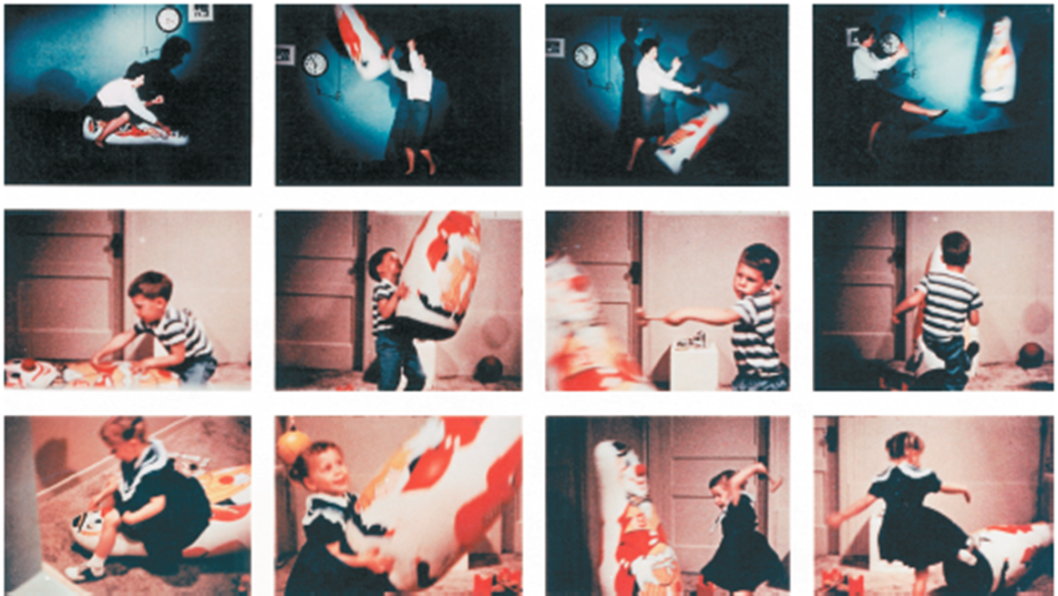
Figure 8-4 Modeling Aggression
This series of photos is from Albert Bandura’s classic Bobo doll experiment, designed to illustrate social learning of aggression. The photos clearly show how the adult model’s aggressive behavior (in the first row) is imitated by children who had viewed the aggressive behavior (second and third rows).
Notes:
This series of photos is from Albert Bandura's classic Bobo doll experiment, designed to illustrate social learning of aggression.
The photos clearly show how the adult model's aggressive behavior (in the first row) is imitated by children who had viewed the aggressive behavior (second and third rows).

Slide 70
Viewing Violence on TV: Does It Matter?
Overwhelming weight of research evidence suggests that observation of televised aggression does lead to subsequent aggression
Children’s television programs contain higher levels of violence (69 percent) than other types of programs (57 percent)
In an average hour, children’s programs contain more than twice as many violent incidents than other types of programs
Observation of media violence can lead to a greater readiness to act aggressively, initiate bullying, and adopt an insensitivity to the suffering of victims of violence

Slide 71
Do Violent Video Games Make Children Violent?
Exposed to aggression
Desensitization of violence
Lack of empathy
Lack of helping behavior
Notes:
Ask: Using sheet provided, list positive and negative effects of video games playing on children.
Provide Fact Sheet on Effects of Video Games on Children (http://www.mediafamily.org/facts/facts_effect.shtml)
Ask: How many “facts” are on your list?
Discussion Questions:
Is the violence rewarded or punished? What are the consequences? How graphic is the violence? Is the violence against humans or inanimate objects? Is the violence sexual? How can parents and caregivers know?

Slide 72

Copyright
Notes:
If this slide was not included in the original PPT, it should be added.

